Slide 1
Advanced Modeling for Distribution Planning with OpenDSS
Instructor
Roger C. Dugan Sr. Technical Executive Sacramento, California June 22-23, 2017

Slide 2

Instructor
Roger C. Dugan, Life Fellow, IEEE
Roger is a Sr. Technical Executive with EPRI in Knoxville, Tennessee USA. He has over 45 years of combined experience in distribution engineering with EPRI, Electrotek Concepts, and Cooper Power Systems. He holds the BSEE degree from Ohio University and the Master of Engineering in Electric Power Engineering degree from Rensselaer Polytechnic Institute, Troy, NY. Roger has worked on many diverse aspects of power engineering over his career because of his interests in applying computer methods to power system simulation. Beginning with a student internship with Columbus and Southern Ohio Electric Co, his work has been focused on Distribution Engineering. He was elected a Fellow of the IEEE for his contributions in harmonics and transients analysis. Recently, he has been very active in distributed generation, particularly as it applies to utility distribution systems and distribution system analysis. He was the 2005 recipient of the IEEE Excellence in Distribution Engineering Award. He is coauthor of Electrical Power Systems Quality published by McGraw-Hill, now in its 3rd edition. He serves on the IEEE PES Distribution System Analysis Subcommittee and is active in the Distribution Test Feeders WG.

Slide 3
Storage Model

Slide 4
Introduction
Storage is a frequently-proposed solution to renewable generation issues
US states and Canadian provinces are requiring large amounts of storage
(Cal: 1.3 GW by 2020; 425 MW on distribution)
Significant amounts are expected on Distribution systems
controlled for benefit of Transmission

Slide 5
Introduction, cont’d
Distribution planners accustomed to static power flow calculations
Accurate analysis of storage requires sequential-time simulation (“QSTS”)
This presentation:
summary of EPRI research into modeling energy storage for planning

Slide 6
Applications of Storage on Distribution
Smoothing solar PV power output
Extending solar PV output into the evening
Support of the Transmission grid
Extending capacity of existing assets
Supporting alternate feeds during reconfiguration
Controlling frequency of a microgrid
Increasing short circuit strength of a microgrid

Slide 7
Planning Issues Introduced by Storage
Overvoltages while discharging
Low voltages while charging
Voltage regulation while compensating for transmission grid support
Interference with overcurrent protection scheme
Insufficient short-circuit capacity in microgrid

Slide 8
The Planning Problem with Storage is More than Capacity to meet Demand
Storage is a variable resource but it is also Limited
Planning tools must account for energy stored
Has a limited ramp rate
Has to be recharged at some other time
Has losses
Charge-discharge cycle (~15-20%)
Idling losses (temperature dependent)

Slide 9
6 Simulation Modes Have Been Identified and Implemented in OpenDSS Program
Static (charge or discharge at specific rate)
Time (charge or discharge at specific time)
Peak Shave
Load Following
Loadshape Following (define a loadshape)
Dynamics (i.e., electromechanical transients)

Slide 10
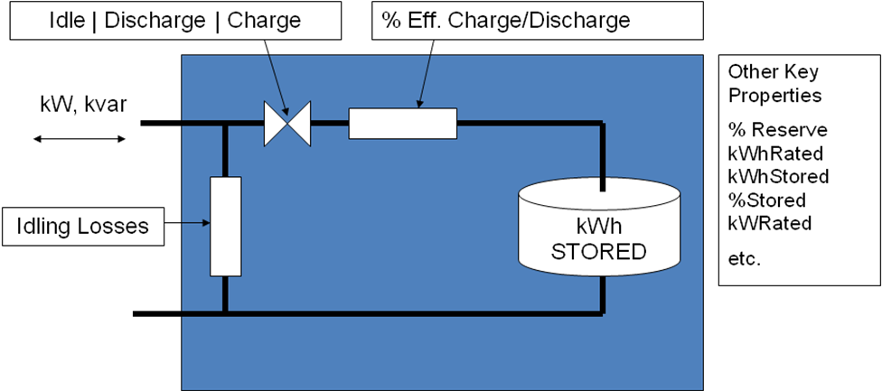
EPRI’s OpenDSS Employs a Generic Energy Storage Element

Slide 11
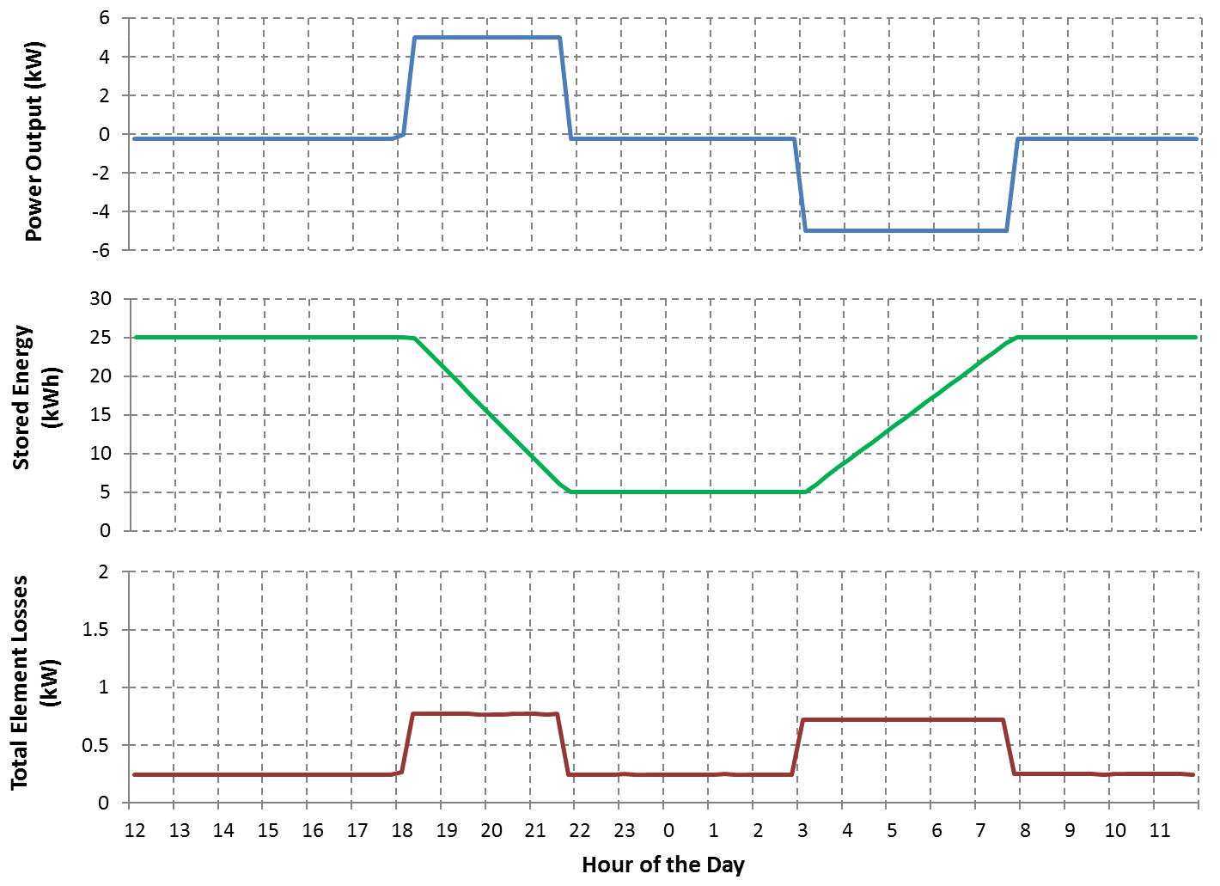
Storage Element Operation

Slide 12
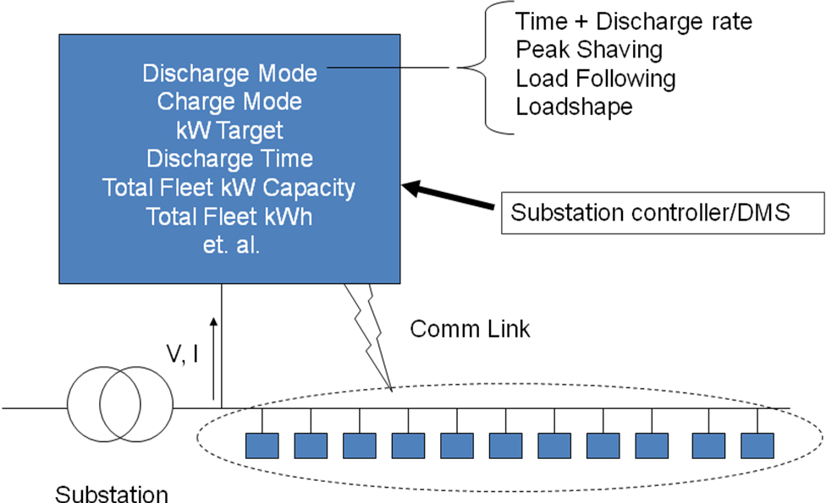
Storage Controller Model
Fleet of Distributed Energy Storage Elements

Slide 13
Peak Shaving Applications
Time step size: 15-60 min

Slide 14
Compensating for Renewable Generation
Extend solar PV output into evening peak.

Slide 15
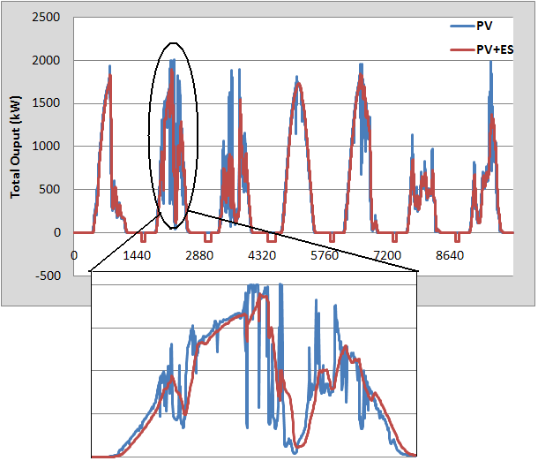
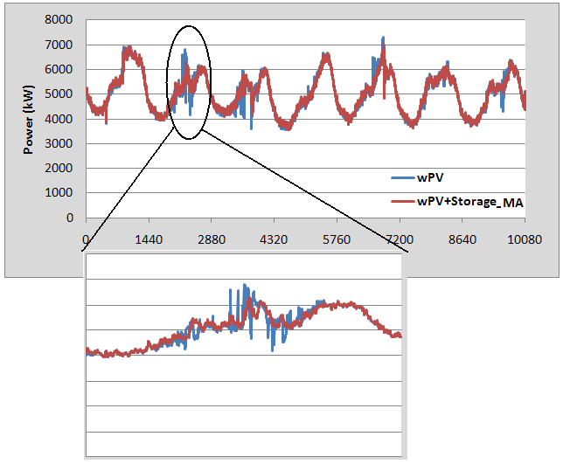
Intermittent Generation Smoothing
Network Response
PV Output

Slide 16
Storage Power Output for Smoothing

Slide 17
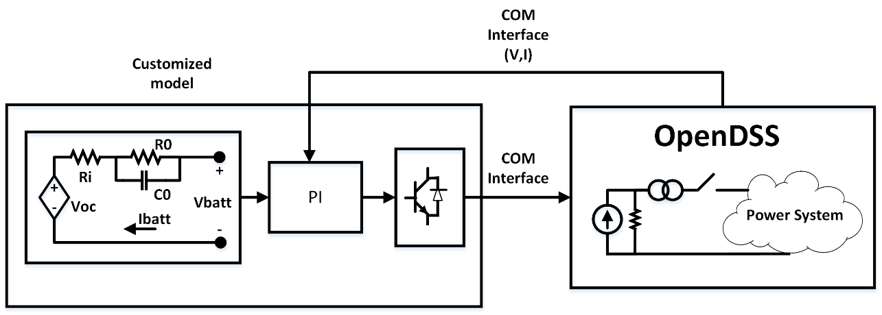
A Dynamics Example (Black start of a Microgrid)
Model may require more than 30 parameters.

Slide 18
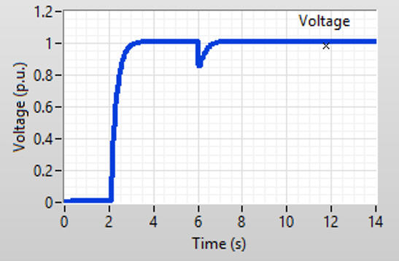
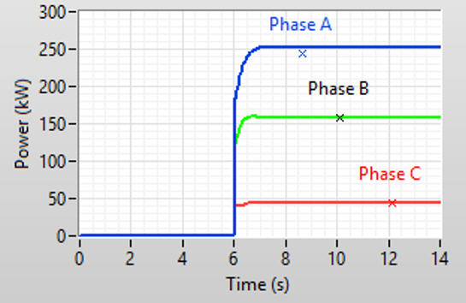
Results from the Model

Slide 19
How to Support Vendor-Supplied Models for Complex Storage System Models
Establish common software interface (DLL?)
Variants for QSTS, Dynamics, and EMT
Windows dominant platform in US for distribution
DSA vendors will have to support
Storage system vendors will want protection

Slide 20
Simplified Distribution Planning
System Performance Considerations
Overvoltages while discharging
Low voltages when charging
Voltage regulation interaction (bulk system dispatch)
Interference with overcurrent protection
Short circuit capacity when islanded
At least two accommodation screens:
Max output / min load
Max charge / max load

Slide 21
Default OpenDSS Storage Model Dispatch

Slide 22
OpenDSS Storage Model Dispatch (Follow Mode)

Slide 23
Script for Follow-mode Simulation
Clear
New Circuit.TestStorage BasekV=12.47
New Line.Line1 Bus1=Sourcebus LoadBus ! default line
New Loadshape.DailyShape npts=96 minterval=15
~ mult=[file=storagetestshape.csv]
New Storage.Battery phases=3 Bus1=loadbus kV=12.47
~ kW=250 kWrated=250 kWhrated=1000
~ dispmode=follow daily=dailyshape
set voltagebases=[12.47]
calcv
new monitor.PQ storage.battery 1 ppolar=no mode=1
new monitor.vars storage.battery 1 mode=3
solve
solve mode=daily step=15m number=(2 96 *)

Slide 24
Example Results in Follow Mode

Slide 25
Example Storage Definition Scripts
! simple Standalone Storage model
New storage.JO0235000540_1 phases=1
~ bus1=X_50_4921721_JO0235000513.1 yearly=Phasealoadshape
~ kV=0.24 kwrated=25 pf=1.0 kwhrated=25 state=IDLING
~ DischargeTrigger=0.8 ChargeTrigger=0.6
! A StorageController Definition
New StorageController.CESmain element=line.568_4921721 terminal=1
~ kWTarget=7000 PFTarget=0.98
~ %ratecharge=30
~ eventlog=y
~ modedischarge=follow TimeDischargeTrigger = 13 ! ---- 12

Slide 26
Example Storage Definition Scripts - DynaDLL
! Example with experimental user-written DynaDLL
New Storage.Store1 phases=3 Bus1=LVBus kV=0.400 conn=Delta kVA=60
~ kWrated=60 kWHrated= 0.20833 %reserve=50 // 750 kW-s (kJ)
~ state=discharge
~ kW=50 PF=1
~ DynaDLL="C:\Users\prdu001\OpenDSS\Source\DESS1\Dess1.DLL"
~ DynaData=(file=DESSModel_Test.TxT)

Slide 27
A Creative Yearly Simulation Script With Variable Dispatch Targets
set mode=yearly stepsize=0.25h
Set overloadreport=true voltexceptionreport = true
set demand=true DIVerbose=true
solve number=760
StorageController.CESmain.kWtarget=8000
solve number=120
StorageController.CESmain.kWtarget=7500
solve number=96
StorageController.CESmain.kWtarget=7000
solve number=472
StorageController.CESmain.kWtarget=7500
solve number=200
StorageController.CESmain.kWtarget=7000
solve number=(2784 200 - 472 - 96 - 120 - 760 -) ! Balance of 2784
closeDI

